Slide 1


Bridging Corpora
Creating Learner Pathways Across Texts
Hugh Paterson III, Bret Mulligan, Anna Lacy, Patricia Guardiola. 2023.Bridging Corpora: Creating Learner Pathways Across Texts. Vienna, Austria. September 13th. Presentation slides Copyright 2023 licensed: CC-SA-ND.

Slide 2
Learning through Exposure to texts
Where in a learning experience does a given text belong?
How can teachers help their students create learning momentum?

Slide 3
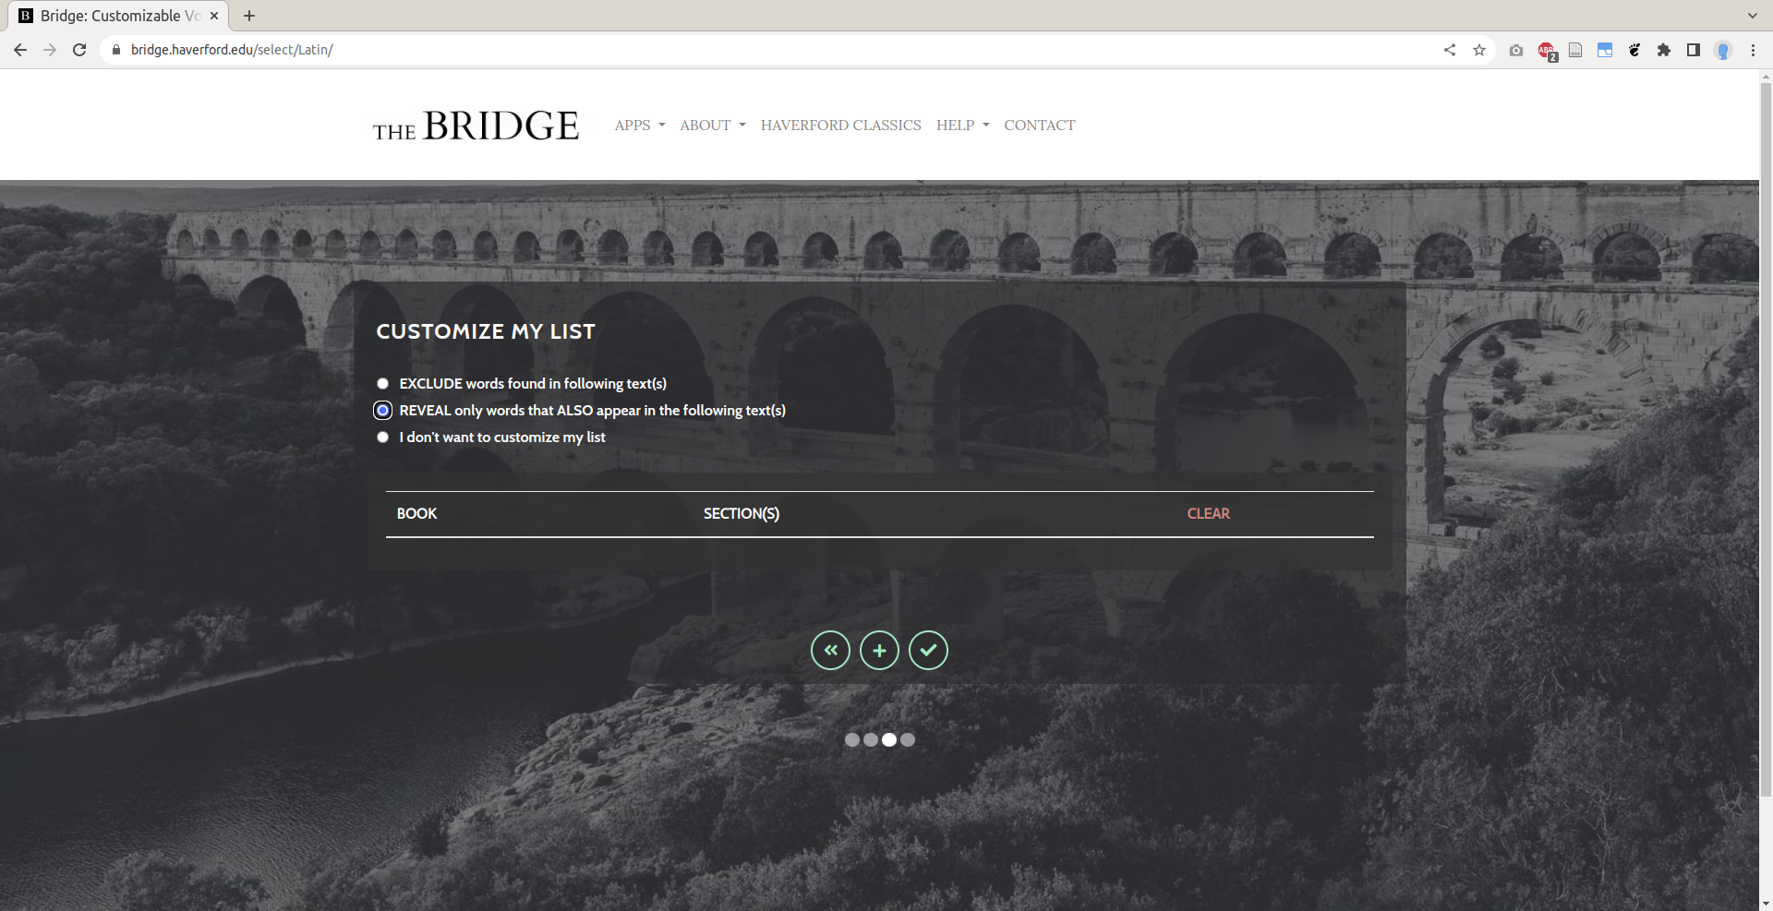

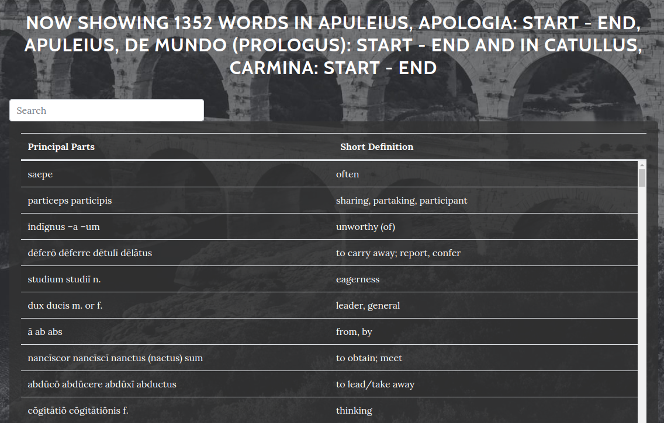
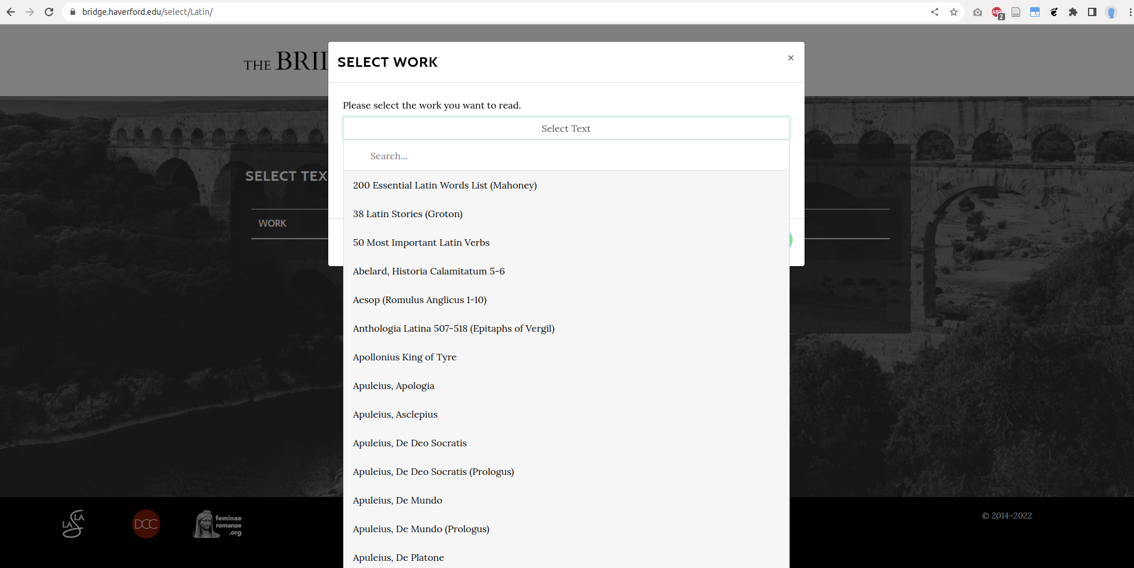
Text Filtering

Slide 4

The Guts
Lemmatization

Slide 5
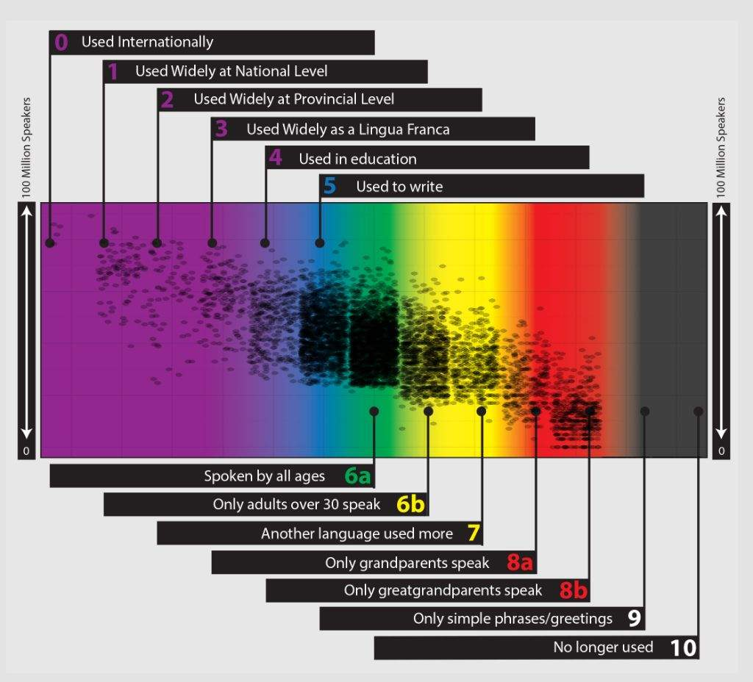
CEFR Challenges
Low Resource Languages
Lack of Certain Modalities
Certain Communities
CEFR

Slide 6
Hugh Paterson III -- i@hp3.me
Brett Mulligan -- bmulliga@haverford.edu

